Slide 1
Male Circumcision: Policy & Programming
Key Resources
Notes:
1

Slide 2
Knowledge Check
Answer the following questions to see how much you know about this topic.
The Clearinghouse on Male Circumcision for HIV Prevention has a searchable resources database.
True
False
The self-paced learning resource package for Male Circumcision under Local Anaesthesia includes:
Reference manual
Course guide for trainers
Course workbook for participants
Supplement on diathermy and service efficiency
b and c
a, b, and c
a, b, c, and d
The MOVE document, Considerations for Implementing Models for Optimizing the Volume and Efficiency of Male Circumcision Services, recommends a single efficiency model.
True
False

Slide 3
Knowledge Check (continued)
Answer the following questions to see how much you know about this topic.
4. Make the BEST match.
A Guide to Indicators for Male Circumcision Programmes in the Formal Health Care System
PEPFAR-funded Program Indicators
Decision Makers' Program Planning Tool (DMPPT)
The Potential Cost and Impact of Expanding Male Circumcision in 14 African Countries
WHO/UNAIDS: New Data on Male Circumcision and HIV Prevention: Policy and Programme Implications
Presents eleven conclusions
Outlines seven male circumcision indicators
Includes a costing and an impact model
Suggests indicators that might be effective
Presents a scale-up scenario for 2009 to 2025

Slide 4
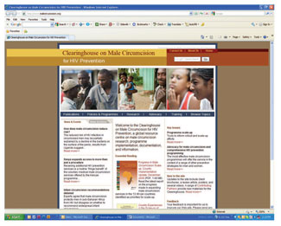
Clearinghouse on Male Circumcision for HIV Prevention
The Clearinghouse on Male Circumcision (MC) for HIV Prevention is a collaborative effort to generate and share information resources with the international public health community, civil society groups, health policy makers, and program managers.
Did You Know?
The MC Clearinghouse provides links to publications and includes a searchable resources database.
Notes:
The Clearinghouse aims to provide:
Basic information resources
An inventory of research activities on MC
Tools, guidelines, and resources for program scale-up
Evidence-based protocols and guidelines
A compendium of better and best practices
A forum for sharing innovations in the delivery of MC services
A global mechanism for exchanging and integrating information on MC programs and associated services
The Clearinghouse is supported by a grant to the World Health Organization (WHO) from the Bill & Melinda Gates Foundation.
(Note: You can visit the Clearinghouse on MC for HIV Prevention Web site at http://www.malecircumcision.org/.)

Slide 5
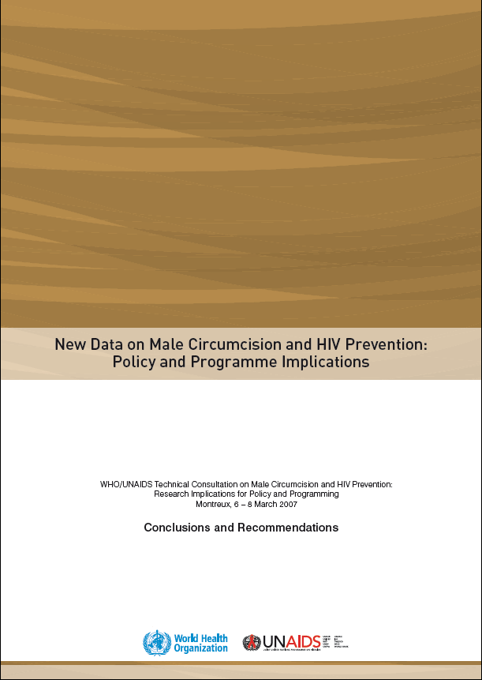
WHO/UNAIDS: New Data on Male Circumcision and HIV Prevention: Policy and Programme Implications
In March 2007, WHO and the UNAIDS Secretariat convened an international expert consultation, in Montreux, Switzerland, to determine whether MC should be recommended for HIV prevention.
As a result of this consultation, WHO and UNAIDS published a set of eleven conclusions with accompanying recommendations.
Source: WHO and UNAIDS 2007b
Did You Know?
You can access the complete WHO-UNAIDS report, titled New Data on Male Circumcision and HIV Prevention: Policy and Programme Implications, on the WHO Web site.
Notes:
This consultation was called in response to the following key factors:
Urgent need to reduce the number of new HIV infections globally
Strong evidence that MC reduces the risk of heterosexually acquired HIV infection in men by approximately 60%, provided by three randomized controlled trials (in Kisumu, Kenya; Rakai District, Uganda; and Orange Farm, South Africa)
(Note: You can find the eleven conclusions excerpt in the accompanying MC Offline Course Resources folder in the file named ElevenWHOUNAIDSConclusions.pdf. You can see the complete WHO-UNAIDS report, titled New Data on Male Circumcision and HIV Prevention: Policy and Programme Implications, on the WHO Web site at http://www.who.int/hiv/pub/malecircumcision/research_implications/en/.)

Slide 6
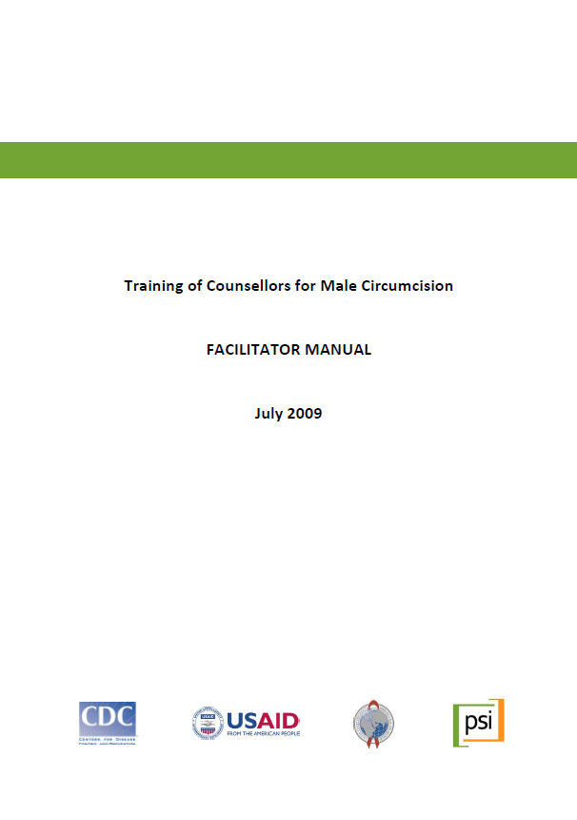
PSI MC Counseling Curriculum
This training package, Training of Counsellors for Male Circumcision, including facilitator and participant manuals, was developed and produced by Population Services International (PSI), for an MC program in Swaziland, in collaboration with the US Centers for Disease Control and Prevention (CDC), USAID, and the US President's Emergency Plan for AIDS Relief (PEPFAR) program.
Source: PSI et al. 2009
Did You Know?
This training program can be used as a:
1. Stand-alone workshop for individuals who have already been trained in client-centered HIV counseling and testing and referrals OR
2. Supplement to existing curricula for HIV counselors who will also serve as MC counselors
Notes:
The package was tested and refinements made based on participant feedback.
Training Program Goals and Objectives
This four-day training curriculum aims to prepare counselors and nurses to provide MC counseling to men, women, and parents.
By the end of this training, participants are expected to be able to:
Correctly cite the principal risks, benefits, and postoperative care procedures for MC
Apply client-centered counseling techniques (e.g., active listening, open-ended questions, offering options) to MC and post-procedure risk reduction counseling
Explain the ethical and legal considerations that surround MC in the country
(Note: You can find the Facilitator Manual and the Participant Manual in the accompanying MC Offline Course Resources folder in the files named MC_counsellor_facilitator_manual_July09.pdf and MC_counsellor_participant_manual_July09.pdf.)
Source: PSI et al. 2009

Slide 7
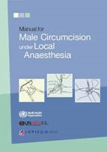
MC Self-Paced Learning Resource Package
The Manual for Male Circumcision under Local Anaesthesia provides technical guidance and information on comprehensive MC services.
Technical guidance is provided on the surgical procedures for performing circumcisions for males of all ages – adults and adolescents, young boys, and neonates.
These materials are designed for use by qualified clinical trainers to instruct health service providers on how to offer MC competently to adults and adolescents under local anesthesia.
The MC self-paced learning resource package includes the reference manual, a course guide for trainers, a course workbook for participants, and a supplement on diathermy and service efficiency.
Sources: WHO, UNAIDS, and Jhpiego 2009; WHO, UNAIDS, and Jhpiego 2010a; WHO, UNAIDS, and Jhpiego 2010b; WHO, UNAIDS, and Jhpiego 2010c
Notes:
The Manual for Male Circumcision under Local Anaesthesia provides technical guidance and information on comprehensive MC services, including: the benefits and risks, linking MC to other sexual and reproductive health services for men, educating and counseling clients and obtaining consent, facilities and supplies, surgical procedures for adults and adolescents, circumcision of infants and children, postoperative care, infection prevention, and managing circumcision services.
A set of self-paced, individual learning materials complement the MC manual. The MC self-paced learning resource package includes the reference manual, a course guide for trainers, a course workbook for participants, and a supplement on diathermy and service efficiency.
(Note: You can find all of these learning materials in the accompanying MC Offline Course Resources folder: the reference manual in the file named MC_manual_local anaesthesia2009.pdf, the course guide for trainers in the file named MCTrainerBook_final.pdf, the course workbook for participants in the file named MCParticipantBook_final.pdf, and the supplement in the file named MCSupplement_final.pdf.)
Did You Know?
This manual was reviewed by actual and potential providers of MC services.
These reviewers represent a range of health care and cultural settings where demand for MC services is high.

Slide 8
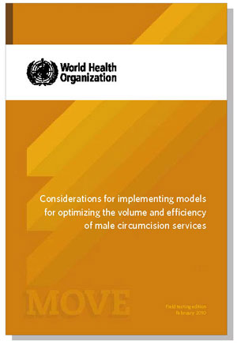
WHO MC MOVE
WHO's Considerations for Implementing Models for Optimizing the Volume and Efficiency of Male Circumcision Services provides guidance to program managers who are involved in setting up or strengthening MC services.
The document outlines considerations and options for organizing adult medical MC surgical services, with the goal of improving efficiency and service volume while assuring a safe service of high quality.
Source: WHO 2010
The document does not recommend a single efficiency model.
Rather, it proposes options for consideration, depending on country circumstances and the local context.
Notes:
The following key areas are addressed:
Clinical considerations
Staff considerations for optimizing efficiency
Optimizing the use of facility space
Client considerations
Supply chain management
Cost efficiencies
Quality assurance
Source: WHO 2010
(Note: You can find the WHO MC MOVE document, titled Considerations for Implementing Models for Optimizing the Volume and Efficiency of Male Circumcision Services, in the accompanying MC Offline Course Resources folder in the file named MCMOVE_who.pdf.)

Slide 9
Commodities and Supply Chain Management
This report, titled PEPFAR MC Partners’ Meeting: Commodities and Improved Coordination of Male Circumcision for HIV Prevention, provides highlights from a meeting of MC implementing partners, held in May 2009, to discuss issues related to supply chain management and to produce a comprehensive list of MC commodities. (PEPFAR MC Technical Working Group 2009)
In addition, an abstract, based on this meeting, titled “Supply Chain Management System and Standard List of Commodities Required to Scale Up Male Circumcision Service for HIV Prevention," (Njeuhmeli et al. 2010b) summarizes options, kits, etc. that have been designed and developed to date. The abstract also summarizes lessons learned in this area and next steps.
Notes:
(Note: The accompanying MC Offline Course Resources folder includes the PEPFAR MC Partners’ Meeting: Commodities and Improved Coordination of Male Circumcision for HIV Prevention report in the file named PEPFAR_MC_CommoditiesMeeting.pdf, and the “Supply Chain Management System and Standard List of Commodities Required to Scale Up Male Circumcision Service for HIV Prevention” abstract in the file named ENjeuhmeliAbstractMaleCircumcisionCommoditiesFinal.pdf.)

Slide 10
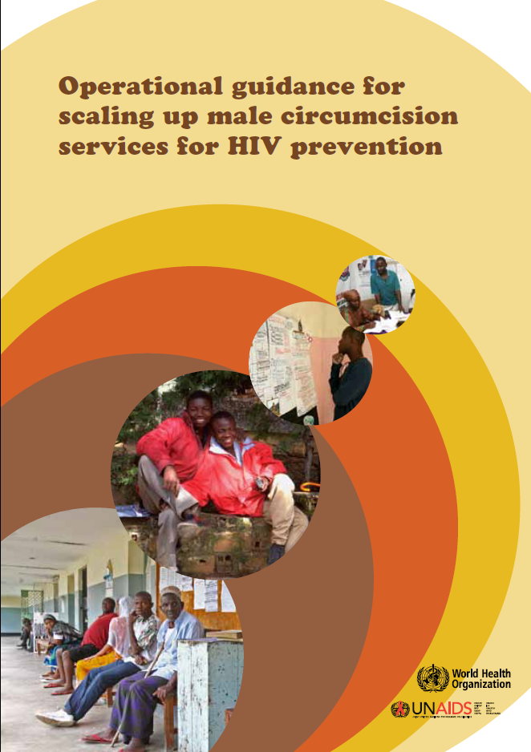
Operational Guidance for Scaling Up MC Services for HIV Prevention
Operational Guidance for Scaling Up Male Circumcision Services for HIV Prevention provides operational and programmatic guidance that can be used in countries or regions that are at various stages of MC scale-up. This document is intended for use by decision makers, program managers, and technical support agencies, and can also provide guidance to funders.
This guidance is relevant to MC scale-up in both the public and private sectors.
Source: WHO and UNAIDS 2008
Notes:
(Note: This operational guidance document is available online at http://www.who.int/hiv/pub/malecircumcision/op_guidance/en/index.html.)

Slide 11
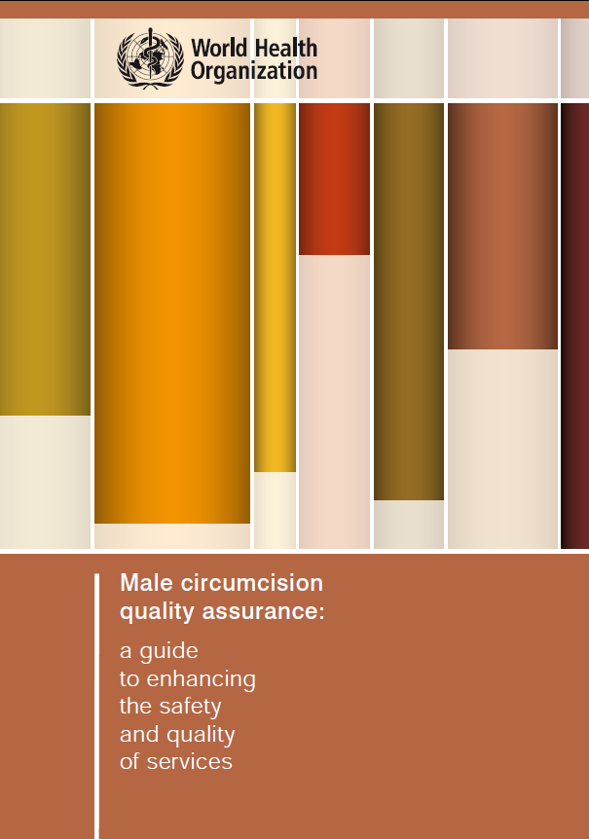
MC Quality Assurance Guide and Quality Assessment Toolkit
The Male Circumcision Quality Assurance Guide can help national and district program and health facility managers and providers establish and implement MC services that meet an internationally agreed-upon level of safety and quality.
This guide can be used to support the establishment of safe and effective MC services in a variety of settings (e.g., health centers, hospitals, mobile units, temporary sites, centers of excellence).
The guide is complemented by the Male Circumcision Quality Assessment Toolkit. This toolkit is a practical set of tools that can help facility managers and providers assess their own performance and the quality of care provided. It can also help them define gaps that exist in MC service provision.
Sources: WHO 2008; WHO 2009a
Notes:
(Note: The quality assurance document is available online at http://www.who.int/hiv/pub/malecircumcision/qa_guide/en/. The quality assessment toolkit is available online at http://www.who.int/hiv/pub/malecircumcision/qa_toolkit/en/.)

Slide 12
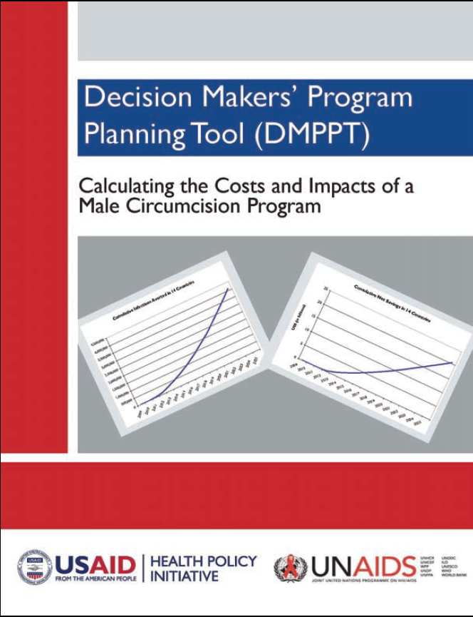
USAID/HPI and UNAIDS DMPPT
The MC Decision Makers’ Program Planning Tool (DMPPT) is designed to support policy development and planning for scaling up the provision of safe MC services. It enables analysts and decision makers to understand the costs and impact of policy options.
The DMPPT is part of a toolkit developed by UNAIDS/WHO that provides guidelines on comprehensive approaches to MC, including types of surgical procedures and key policy and cultural issues.
Source: USAID/HPI and UNAIDS 2009
Did You Know?
The DMPPT MC model contains two sub-models:
1. Costing model
2. Impact model
Notes:
The MC DMPPT model addresses the following main policy areas:
Priority populations: All male adults, young adults, adolescents, neonates, and most-at-risk groups
Target coverage levels and rates of scale-up
Service delivery modes: hospital, clinic, mobile van; public, private, nongovernmental organization, and "other"
Task shifting
Source: USAID/HPI and UNAIDS 2009
(Note: The DMPPT documents are available online at http://www.malecircumcision.org/programs/DMPPT.html.)

Slide 13
Costing and Impact
USAID/HPI Costing and Impact Brief (USAID/HPI 2009)
To support MC scale-up in PEPFAR programs, readily available data have been applied to estimate the potential cost and impact of scaling up medical MC services in 14 countries in eastern and southern Africa to reach 80% of adult/adolescent (ages 15-49 years) and neonatal males by 2015.
Key conclusions:
Scaling up the program could prevent more than four million adult HIV infections during 2009 to 2025 with a cumulative net savings of US$20.2 billion over this period.
The Potential Cost and Impact of Expanding Male Circumcision in 14 African Countries
Notes:
Results presented in this brief, The Potential Cost and Impact of Expanding Male Circumcision in 14 African Countries (pictured above), illustrate one of several possible scenarios. Key conclusions from this initial scenario are that scaling up the program could prevent more than four million adult HIV infections during 2009 to 2025 with a cumulative net savings of US$20.2 billion over this period.
(Note: This brief is available online at http://www.malecircumcision.org/programs/documents/14_country_summary11309.pdf.)
Did You Know?
USAID/HPI has also produced a cost and impact brief for each of the 14 African countries.
(Note: Each of these country-specific briefs is available online. The url for each of these country-specific briefs can be found in the References & Links document in the accompanying MC Offline Course Resources Package. You can find the References & Links document in the file named References&Links.pdf.)

Slide 14
Costing and Impact (continued)
In addition, “Costing and Impact of Expanding Male Circumcision Services in 14 Countries in Eastern and Southern Africa: Results of a Desk Review Using the DMPPT” (Njeuhmeli et al. 2010a), an oral presentation given at the XVIII International AIDS Conference in Vienna, summarizes use of the MC DMPPT to project the cost and impact of rapidly scaling up medical MC in 14 countries in eastern and southern Africa. Based on results determined using a mathematical model of country-specific demography and HIV epidemic dynamics, the presentation concludes that:
Medical MC is one of the most compelling and cost-effective HIV prevention interventions available.
A massive and rapid scale-up of safe, voluntary medical MC is warranted based on the likely cost savings and impact on the region's HIV epidemics.
Notes:
(Note: This oral presentation is available online at http://pag.aids2010.org/session.aspx?s=598.)
14

Slide 15
Monitoring & Evaluation
A Guide to Indicators for Male Circumcision Programmes in the Formal Health Care System (pictured at left) looks at interventions that should be common to all MC programs and suggests indicators that might be effective for many or all countries. (WHO and UNAIDS 2009)
Notes:
(Note: A Guide to Indicators for Male Circumcision Programmes in the Formal Health Care System is available online as http://www.malecircumcision.org/programs/documents/MC_ME_final_3_2010.pdf)

Slide 16
Monitoring & Evaluation (continued)
Another document, titled PEPFAR-funded Program Indicators, (PEPFAR 2009b) outlines the following MC indicators:
PEPFAR-funded Program Indicators
Number performed
Adverse events
Facilities
Follow-up rates
Training
National-Level Indicators
Number performed
Percentage circumcised
For the program indicators, tables in this document include: indicator, type of indicator, numerator, denominator, disaggregation, purpose, applicability, data collection frequency, measurement tool, method of measurement, interpretation.
Notes:
(Note: You can find the PEPFAR-funded Program Indicators document in the accompanying MC Offline Course Resources folder in the file named MCIndicators1-5FINALSETDec2009.pdf.)
16

Slide 17
Additional MC Resources Available Online
Male Circumcision: Global Trends and Determinants of Prevalence, Safety and Acceptability (WHO and UNAIDS 2007a)
Safe, Voluntary, Informed Male Circumcision and Comprehensive HIV Prevention Programming (UNAIDS 2008a)
Male Circumcision Situation Analysis Toolkit (WHO 2009b)
Notes:
(Note: The Male Circumcision: Global Trends and Determinants of Prevalence, Safety and Acceptability document is available online at http://www.who.int/hiv/pub/malecircumcision/globaltrends/en/index.html.
The Safe, Voluntary, Informed Male Circumcision and Comprehensive HIV Prevention Programming document is available online at http://www.malecircumcision.org/programs/documents/UNAIDS_safe_voluntary_MC.pdf.
The Male Circumcision Situation Analysis Toolkit document is available online at http://www.who.int/hiv/pub/malecircumcision/sit_analysis/en/index.html.)

Slide 18
Knowledge Recap
Answer the following questions to see how much you know about this session.
The Clearinghouse on Male Circumcision for HIV Prevention has a searchable resources database.
True
False
The Operational Guidance for Scaling Up Male Circumcision Services for HIV Prevention document is relevant to male circumcision scale-up in:
The public sector
The private sector
Both the public and private sectors
The self-paced learning resource package for Male Circumcision under Local Anaesthesia includes:.
Reference manual
Course guide for trainers
Course workbook for participants
Supplement on diathermy and service efficiency
b and c
a, b, and c
a, b, c, and d

Slide 19
Knowledge Recap (continued)
Answer the following questions to see how much you know about this session.
The MOVE document, Considerations for Implementing Models for Optimizing the Volume and Efficiency of Male Circumcision Services, recommends a single efficiency model.
True
False
Make the BEST match.
A Guide to Indicators for Male Circumcision Programmes in the Formal Health Care System
PEPFAR-funded Program Indicators
Decision Makers' Program Planning Tool (DMPPT)
The Potential Cost and Impact of Expanding Male Circumcision in 14 African Countries
WHO/UNAIDS: New Data on Male Circumcision and HIV Prevention: Policy and Programme Implications
Presents eleven conclusions
Outlines seven male circumcision indicators
Includes a costing and an impact model
Suggests indicators that might be effective
Presents a scale-up scenario for 2009 to 2025

Slide 20
Key Resources Knowledge Recap Answer Key
Please note that the questions and answers match those in the Knowledge Recap. The number and order of questions in the Knowledge Check may differ.
The Clearinghouse on Male Circumcision for HIV Prevention has a searchable resources database.
True
The Operational Guidance for Scaling Up Male Circumcision Services for HIV Prevention document is relevant to male circumcision scale-up in:
c. Both the public and private sectors
The self-paced learning resource package for Male Circumcision under Local Anaesthesia includes:
a, b, c, and d
Notes:
20

Slide 21
Key Resources Knowledge Recap Answer Key (continued)
Please note that the questions and answers match those in the Knowledge Recap. The number and order of questions in the Knowledge Check may differ.
The MOVE document, Considerations for Implementing Models for Optimizing the Volume and Efficiency of Male Circumcision Services, recommends a single efficiency model.
b. False: The MOVE document does NOT recommend a single efficiency model. Rather, it proposes options for consideration, depending on country circumstances and the local context.
Make the BEST match.
A Guide to Indicators for Male Circumcision Programmes in the Formal Health Care System – Suggests indicators that might be effective
PEPFAR-funded Program Indicators – Outlines seven male circumcision indicators
Decision Makers' Program Planning Tool (DMPPT) – Includes a costing and an impact model
The Potential Cost and Impact of Expanding Male Circumcision in 14 African Countries – Presents a scale-up scenario for 2009 to 2025
WHO/UNAIDS: New Data on Male Circumcision and HIV Prevention: Policy and Programme Implications – Presents eleven conclusions
Notes:
21

