Slide 1
Male Circumcision: Policy & Programming
Optimizing Efficiency
Notes:
1

Slide 2
Knowledge Check
Answer the following questions to see how much you know about this topic.
How much do you know about male circumcision (MC) efficiency techniques? Make the best match.
Assigns less complex steps to lower credentialed, but highly trained health care cadres
Uses highly trained non-physician providers to complete all steps of MC surgery
Can help distribute the work load throughout the day
Multiple clients receive MC at the same time, performed by a team of providers
Efficiency model for MC surgery
Task shifting
Task sharing
Sector Booking
Benefits of using mobile male circumcision teams to penetrate rural areas include all of the following EXCEPT:
An easy solution to space and mobility challenges
Easily adjustable to specific circumstances and local challenges
Easy to maintain standards of hygiene and sterility
Cost-effective (can make use of natural resources)
Notes:
2

Slide 3
Knowledge Check (continued)
Answer the following questions to see how much you know about this topic.
Optimal client flow should do all of the following EXCEPT:
Minimize client contact with hazardous surgical waste
Provide a single entry/exit point in the clinic
Provide a recovery area where clients can rest and be monitored, as needed
Provide an area where the client can be given postoperative counseling, in private
All of the following surgical techniques are being considered to optimize efficiency EXCEPT:
Using the sleeve resection technique
Using diathermy (electrocautery) to stop bleeding
Wrapping surgical instruments together instead of individually
Using a multiple-bed theater layout

Slide 4
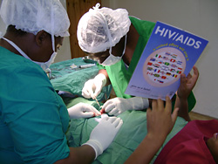
A Challenge: How to Use Time and Resources Efficiently While Ensuring High Quality
As program managers plan for implementation and scale-up of MC services, they will be faced with a challenging question: How can we match supply to demand so that time and resources can be used as efficiently as possible while ensuring that surgical results are of high quality?
A relaxed client undergoes MC in Swaziland.
Notes:
The previous session focused on ways to ensure that MC services achieve and sustain a high level of quality.
This session explores a number of ways to optimize efficiency (e.g., task shifting, task sharing, sector booking, and efficient use of facility space).

Slide 5
A Challenge: How to Use Time and Resources Efficiently While Ensuring High Quality (continued)
Highlights
As a first step in initiating or expanding access to MC, undertake a needs assessment to map out:
Anticipated scope of MC scale-up
Human resource and training needs
Infrastructure, commodity, and logistic requirements
Costs and funding
Systems for monitoring, evaluation, and follow-up
Source: WHO and UNAIDS 2007b
Notes:
5

Slide 6
Efficient Use of Staff and Training: Task Shifting and Task Sharing
A surgeon* does not need to perform all of the main steps in MC surgery (see list of ten main MC surgical steps on the notes page below). To increase the efficiency of MC service delivery, some of these steps can be shared or shifted. Decisions about which steps are shared – or if all steps are shifted – will need to be made based on staff realities, national laws/regulations, and individual aptitudes.
Source: WHO 2010
*In this course, the term surgeon refers to the person on the MC surgical team who does the cutting. This could be an appropriately trained doctor, nurse, or clinical officer.
Highlights: Without task sharing, the time required for an experienced MC provider to complete one MC is approximately 25 minutes.
Notes:
The following is the list of ten main surgical steps:
Main MC Surgical Steps
Injection of local anesthesia
2. Surgical preparation (disinfection and draping of the site)
3. Marking
4. Palpation of glans (head of penis)
5. Placement of forceps
6. Surgical removal of the foreskin (including dissection for sleeve resection)
7. Hemostasis (stopping the bleeding)
8. Placement of four mattress sutures
9. Placement of simple interrupted sutures
10. Dressing
Source: WHO 2010

Slide 7
Efficient Use of Staff and Training: Task Shifting and Task Sharing (continued)
Task shifting: shifting tasks (or steps) from doctors to clinical officers and nurses, use of highly trained non-physician providers to complete all steps of MC surgery
Task sharing: assigning less complex tasks or steps to lower credentialed, but highly trained health care cadres
For both task shifting and task sharing, a highly experienced provider must supervise and mentor the less experienced providers so that risks to the MC client are minimized.
Source: WHO 2010
Notes:
7

Slide 8
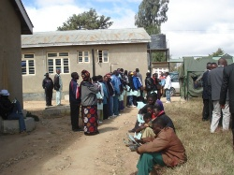
Optimal Client Scheduling
Client scheduling has a major impact on efficiency. For some communities and facilities, sector booking may work better than individual booking.
In communities where individual appointments are frequently not kept, efficiency may be severely hampered by periods of minimum activity that are followed by periods of overwhelming catch-up.
Source: WHO 2010
Clients wait for individual MC counseling in Iringa, Tanzania.

Slide 9
Optimal Client Scheduling (continued)
To save staff and client time, the work day can be divided into sectors (e.g., three sectors of three-and-one half hours each). Clients can be booked for a specific sector (e.g., 8:30 am to 12 noon) and asked to arrive at the starting time for that sector. Using sector booking, the client's waiting time would usually be a maximum of the duration of the sector (i.e., three and one-half hours).
Sector booking is preferable to mass daily booking, in which clients might be asked to come at any time during the work day (e.g., 8:30 am to 4:30 pm).
Source: WHO 2010
Highlights: Factors to Consider
Appropriate staff to client ratio
Minimum client waiting time
Maximum number of surgeries per day per clinician team
Operating rooms effectively scheduled
Realistic time frames allotted for surgeries and clean-up between surgeries
Source: WHO 2010
Notes:
9

Slide 10
Optimal Client Flow
Client flow should be coordinated through the facility to avoid congestion and confusion and save client and staff time. Client flow should:
Minimize client contact with hazardous surgical waste
Provide easy access to separate entry and exit points at opposite ends of the clinic (ideally)
Provide a recovery area close to the exit where clients can rest and be monitored, as needed
Provide an area near the exit point where the client can be given, in privacy: postoperative counseling, an information leaflet about postoperative instructions and complications, and a follow-up appointment.
Source: WHO 2010

Slide 11
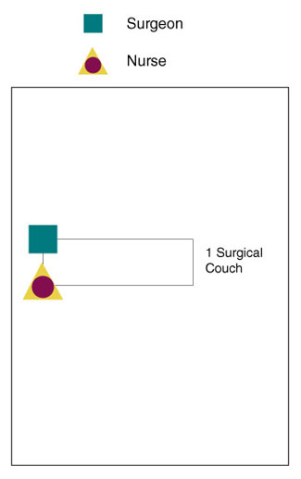
Efficient Use of Facility Space: Conventional Surgical Approach
In the conventional surgical approach (see illustration on the left), typically one surgeon, assisted by one nurse, performs all steps of the MC surgery for one client.
However, given the need for rapid scale-up of MC service delivery, modifications in this approach need to be considered to improve efficiency.
Source: WHO 2010

Slide 12
Efficient Use of Facility Space: Conventional Surgical Approach (continued)
Highlights: The conventional surgical layout and staff-to-client ratio can be modified to support task sharing and task shifting.
Source: WHO 2010
Did You Know?
One surgeon working with one assistant – and one surgical bed – only allows an average of eight to ten MCs per day.
Source: Adapted from WHO 2010
Notes:
12

Slide 13
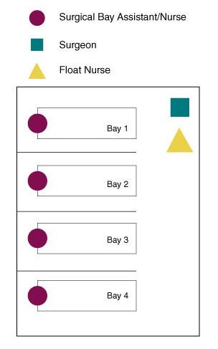
Efficient Use of Facility Space: Modified Approach
The graphic shows an example of a surgical layout, in which space and staff ratios are modified to accommodate the need for rapid scale-up of MC.
In this model, four clients receive MC at the same time, performed by a team of providers.
Source: Adapted from WHO 2010
Did You Know?
Using an efficiency approach, one team should be able to perform more than 25 MCs per day.

Slide 14
Efficient Use of Facility Space: Modified Approach (continued)
Floor space is laid out as four surgical bays that are separated for privacy.
A single surgeon moves from bay to bay,* removing the foreskin, achieving/ensuring hemostasis, and performing mattress suturing for each of four MC clients.
A single float nurse moves from bay to bay,* following the surgeon and doing simple sutures for each of four MC clients.
Four surgical bay assistants/nurses, one assigned to each bay, remain in place. Each of these nurses preps, drapes, provides local anesthesia for, assists in surgery for, and bandages a single MC client.
Source: Adapted from WHO 2010
Highlights: To increase efficiency, surgical gowns only need to be changed if soiled with blood or body fluids.
*As MC providers move from bay to bay, it is important for them to attend to infection prevention protocols (washing/sanitizing hands, changing gloves, and changing gowns, if soiled, between clients).
Notes:
14

Slide 15
Rakai Study: Optimizing Speed
In Rakai, Uganda, Kiggundu et al. assessed adult MC procedures after training to assess surgical skill and speed.
After completing training (which included 15 to 20 supervised procedures), six physicians circumcised 3,011 men (median age 24 years) using the sleeve resection method* in a randomized trial (20 to 981 procedures per surgeon).
Duration of surgery was timed from local anesthesia to wound closure.
Results: For the first 100 procedures, it took an average of approximately 40 minutes to complete the surgery. For the subsequent 100 circumcisions, the time to complete the surgery decreased to 25 minutes.
Source: Kiggundu et al. 2009
*You can find more information on surgical procedures for MC (including the sleeve resection technique) in the Adult/Adolescent MC Surgical Techniques session of this course.

Slide 16
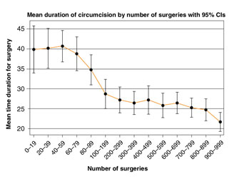
Rakai Study: Optimizing Speed (continued)
You Decide . . .
As the graph on the left illustrates, newly trained physicians in Rakai needed to complete about 100 MCs to reach optimal surgical speed.
What implications does this have for MC programming?
Source: Kiggundu et al. 2009
Notes:
16

Slide 17
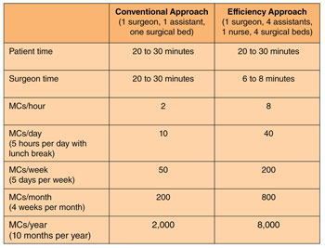
Efficiency and Productivity Comparison: Conventional Approach Compared to Efficiency Approach
The chart on the left shows that an efficiency approach to MC surgery can perform much more efficiently and productively than a conventional approach.
In some sites, productivity could be further increased by hosting additional efficiency teams.

Slide 18
Efficiency and Productivity Comparison: Conventional Approach Compared to Efficiency Approach (continued)
Application to South Africa: Human Resource Requirements
Based on the efficiency model shown in the chart on the previous slide, to achieve a goal of circumcising six million men in five years, or 1.2 million men per year, South Africa needs:
A total of 150 MC teams
150 surgeons
600 assistants/nurses
150 nurses
This means a total of 900 clinical staff (and 600 surgical beds).
Ideas in Action
Bophelo Pele ("Health First") Project Model in Orange Farm, South Africa
Using an efficiency approach with three task-sharing teams of one medical circumciser and five nurses, this project was able to perform up to 150 adult/adolescent MCs per day.
As of November 2009, 14,011 men had been circumcised, averaging 740 per month over 12 months.
Source: Lissouba et al. 2010
Notes:
18

Slide 19
Surgical Efficiencies to Reduce Time and Cost
To optimize efficiency the following surgical techniques are being considered:
Forceps-guided: In all but the most skilled surgeon's hands, forceps-guided is quicker than dorsal slit or sleeve resection. The forceps-guided technique is easy to teach and can be done without an assistant.
Stopping the flow of blood (hemostasis) using diathermy (electrocautery) can save several minutes per procedure, compared with ligation (tying sutures)
Collective wrap of surgical items: Wrapping surgical instruments together (instead of individually) as pre-assembled surgical kits speeds surgical set-up.
Theater layout for faster client turnover: For example, multiple beds in the room, separated by curtains for privacy
To achieve the greatest cost efficiency and speed, each country will need to determine the optimal combination of approaches based on in-country circumstances.

Slide 20
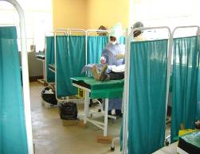
Surgical Efficiencies to Reduce Time and Cost (continued)
Ideas in Action: Case Study
An efficiency model in South Africa has reduced cost per MC to about US$35 by optimizing use of personnel, having seven beds separated by curtains, and using the forceps-guided technique with a surgical disposal kit and diathermy (electrocautery).
Source: WHO 2010
Curtains separate surgical bays to provide client privacy in Ngome Health Center, Iringa, Tanzania.
Did You Know?
WHO and UNAIDS recommend that programs determine appropriate service delivery models locally because these models depend on the local context.
Source: WHO and UNAIDS 2007b
Notes:
20

Slide 21
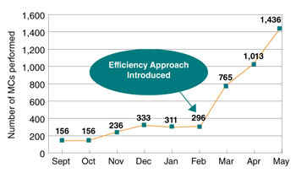
Surgical Efficiencies Increase MC Productivity at Tanzanian Pilot Sites
After a surgical efficiency approach was introduced through on-the-job training in February 2010 in Tanzanian pilot sites, the number of MCs provided per month increased dramatically.
The main efficiency approaches that led to increased productivity were:
Layout: Used multiple surgical beds. This allowed more efficient use of human resources and clinic space, and reduced turnover time between procedures.
Method change: Changed from dorsal slit to forceps-guided, which saves an average of 2:25 minutes per procedure.
Notes:
Did You Know?
New efficiencies will evolve over time.

Slide 22
Efficiency Saves Lives.
In cases of high client demand and turnout, group education and counseling can become a bottleneck if they are not equally efficient as surgical services. This does not mean that education and counseling time need to be reduced for clients when turnout is high.
Rather, programs can use the following strategies to optimize the efficiency of MC education and counseling:
Provide group education, counseling, and testing one or more days prior to the procedure.
Take counselors to the community so that education, counseling, and testing can be provided there. To achieve this, a strong referral system is required. But it can be done! For example, in Iringa, cards were used to indicate which clients had received counseling in the field.
Employ sufficient numbers of counselors to support high-volume surgical sites. Program managers must plan for this.

Slide 23
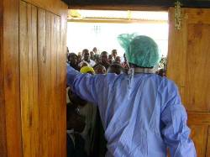
Efficiency Saves Lives. (continued)
Highlights
Remember: Being Efficient Saves Lives!
In Iringa, Tanzania, for every 4.5 MCs one HIV infection can be averted.
High client demand and turnout in Iringa, Tanzania
Notes:
23

Slide 24
Different Service Delivery Sites
MC services can be delivered at a variety of locations. Service delivery models for each site should be based on the same principles of safety and quality assurance discussed in the previous session with considerations for efficiency that are discussed in this session.
Fixed sites may be a good choice in locations where a large number of MC candidates are close by (e.g., in urban areas).
Mobile sites or camp services may be more appropriate for reaching remote areas where MC candidates may find travel to a fixed site difficult because of long distances and poor roads. Temporary MC sites can be set up in tents, single-width trailers, or pre-fabricated containers delivered to the sites.
Outreach services may need to "reach out" to adult and adolescent male populations who are at high risk of HIV infection, but who might not be motivated to seek out MC services.

Slide 25
Different Service Delivery Sites (continued)
Highlights
Projects in the southern Africa region have taught us that correct site location is key to a successful high-volume – and, therefore, cost-efficient – MC clinic. Key factors include:
Proximity to high density populations
Accessibility both by foot and by other means of transportation
Volumes of people passing through the area
Exposure by means of the clinic's visibility and branding
MC outreach services can be provided at locations where MC candidates are likely to be found. For example, existing HIV testing and counseling sites could provide on-site MC counseling and services or referrals to MC service delivery sites.
In addition, outreach services can be extended to traditional MC initiation schools to link initiation rites with safe medical MC.
Notes:
25

Slide 26
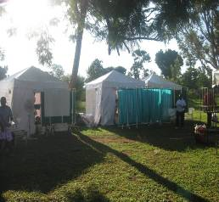
Mobile MC Teams: Lessons Learned from Kenya
Benefits
Mobile MC teams – using tents, trailers, pre-fabricated containers, or existing infrastructure (e.g., schools) – are:
An easy solution to space and mobility challenges
Cost-effective (These facilities can make use of natural resources.)
Easily adjustable to specific circumstances and local challenges
In Kenya, tents and mobile MC teams have been used extensively to penetrate rural areas where clinical space is scarce.

Slide 27
Mobile MC Teams: Lessons Learned from Kenya (continued)
Challenges
Mobile MC teams – using tents, trailers, pre-fabricated containers, or existing infrastructure – may make it more difficult to:
Maintain minimum standards of hygiene and sterility (e.g., if running water is a challenge)
Ensure optimal working conditions (e.g., appropriate heating and lighting)
Wash and process instruments properly
These challenges raise concerns that may make it difficult to obtain Ministry of Health approval. And setting up mobile MC facilities may pose some environmental concerns.
However, despite these challenges, in some cases tents or other mobile structures can provide MC services more effectively than fixed sites.
For example, it may be easier to prevent infection in a "new" mobile structure than in a fixed site that is in poor working condition.
Notes:
27

Slide 28
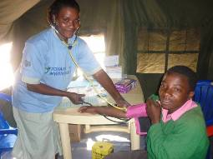
Program Example: Efficient, Comprehensive HIV Prevention Services in Iringa, Tanzania
Clients registered, participated in group education on MC and HIV, and then were counseled individually for HIV and MC (including risk assessment/reduction), and tested for HIV on an opt-out basis (99.2% were tested).
A pre-operative physical exam and screening for sexually transmitted infections (STIs) and congenital abnormalities took place in counseling tents.
The MC campaign in Iringa, Tanzania, achieved efficiency, maintained quality, and offered a comprehensive package of HIV prevention services.

Slide 29
Program Example: Efficient, Comprehensive HIV Prevention Services in Iringa, Tanzania (continued)
Appointments for the MC procedure were made on a first come, first served basis. Surgery was performed by trained MC providers.
Clients who were HIV-positive were linked to an HIV/AIDS care and treatment center; they were provided with MC if they desired, according to national guidelines.
Clients with medical/surgical problems or STIs were referred for continued care.
Clients who received MC were given a postoperative review as well as two postoperative follow-up visits at 48 hours and again at seven days after surgery.
Notes:
29
Highlights
During the six-week MC campaign for HIV prevention in Iringa, Tanzania, (in June and July 2010) 10,352 MCs were completed in 36 days at five sites.
After the campaign, sites have continued to perform MC.
In August 2010, approximately 1,000 MCs were completed.

Slide 30
Recommended Next Steps for Scaling Up MC Services Using Principles that Address Efficiency
Establish performance improvement teams to evaluate existing sites and recommend focused changes that apply relevant efficiency principles.
Tailor training programs and design future clinics using efficiency principles.
Generate demand to ensure steady, large-volume client flow through MC sites.

Slide 31
Recommended Next Steps for Scaling Up MC Services Using Principles that Address Efficiency (continued)
Continue to develop innovative approaches and settings so that MC can be performed efficiently and cost-effectively. For example:
Use tents, trailers, or pre-fabricated containers for counseling and/or surgery in mobile MC.
Obtain better MC kits.
Employ faster surgical techniques.
Use devices that make MC safer and simpler.
Develop plans to convert adult/adolescent MC sites into neonatal sites in the future.
Use community counselors or counseling and testing programs to provide MC counseling and HIV testing and counseling at the community level.
Avoid counseling bottlenecks. Either have enough counselors to provide counseling on the same day as the procedure – or plan to counsel MC clients on a day prior to the MC procedure.
Notes:
31

Slide 32
Knowledge Recap
Answer the following questions to see how much you know about this session.
How much do you know about male circumcision (MC) efficiency techniques? Make the best match.
Assigns less complex steps to lower credentialed, but highly trained health care cadres
Uses highly trained non-physician providers to complete all steps of MC surgery
Can help distribute the work load throughout the day
Multiple clients receive MC at the same time, performed by a team of providers
Efficiency model for MC surgery
Task shifting
Task sharing
Sector Booking
Benefits of using mobile male circumcision teams to penetrate rural areas include all of the following EXCEPT:
An easy solution to space and mobility challenges
Easily adjustable to specific circumstances and local challenges
Easy to maintain standards of hygiene and sterility
Cost-effective (can make use of natural resources)
Notes:
32

Slide 33
Knowledge Recap (continued)
Answer the following questions to see how much you know about this session.
The World Health Organization recommends that only physicians should be trained to perform male circumcision.
True
False
Optimal client flow should do all of the following EXCEPT:
Minimize client contact with hazardous surgical waste
Provide a single entry/exit point in the clinic
Provide a recovery area where clients can rest and be monitored, as needed
Provide an area where the client can be given postoperative counseling, in private
All of the following surgical techniques are being considered to optimize efficiency EXCEPT:
Using the sleeve resection technique
Using diathermy (electrocautery) to stop bleeding
Wrapping surgical instruments together instead of individually
Using a multiple-bed theater layout
Education and counseling time need to be reduced for male circumcision clients when turnout is high.
True
False
Notes:
33

Slide 34
Optimizing Efficiency Knowledge Recap Answer Key
Please note that the questions and answers match those in the Knowledge Recap. The number and order of questions in the Knowledge Check may differ.
How much do you know about male circumcision (MC) efficiency techniques? Make the best match.
Assigns less complex steps to lower credentialed, but highly trained health care cadres—Task sharing
Uses highly trained non-physician providers to complete all steps of MC surgery—Task shifting
Can help distribute the work load throughout the day—Sector booking
Multiple clients receive MC at the same time, performed by a team of providers—Efficiency model for MC surgery
2. Benefits of using mobile male circumcision teams to penetrate rural areas include all of the following EXCEPT:
Easy to maintain standards of hygiene and sterility
The use of mobile male circumcision teams may make it MORE DIFFICULT to maintain minimum standards of hygiene and sterility.
Notes:
34

Slide 35
Optimizing Efficiency Knowledge Recap Answer Key (continued)
Please note that the questions and answers match those in the Knowledge Recap. The number and order of questions in the Knowledge Check may differ.
The World Health Organization recommends that only physicians should be trained to perform male circumcision. b. False: The World Health Organization recommends that countries should identify non-physician providers who can be trained to perform male circumcision.
Optimal client flow should do all of the following EXCEPT:
b. Provide a single entry/exit point in the clinic
Optimal client flow should provide easy access to SEPARATE entry and exit points at opposite ends of the clinic (ideally). The recovery and postoperative counseling areas should be positioned close to the exit.
All of the following surgical techniques are being considered to optimize efficiency EXCEPT:
a. Using the sleeve resection technique
The forceps-guided technique is recommended for efficiency. In all but the most skilled surgeon's hands, forceps-guided is quicker than dorsal slit or sleeve resection.
6. Education and counseling time need to be reduced for male circumcision clients when turnout is high.
b. False: Education and counseling time DO NOT need to be reduced for male circumcision clients when turnout is high. Rather, programs can provide these services one or more days prior to the procedure, provide these services in the community, and employ sufficient numbers of counselors to support high-volume surgical sites.
Notes:
35

